Slide 1
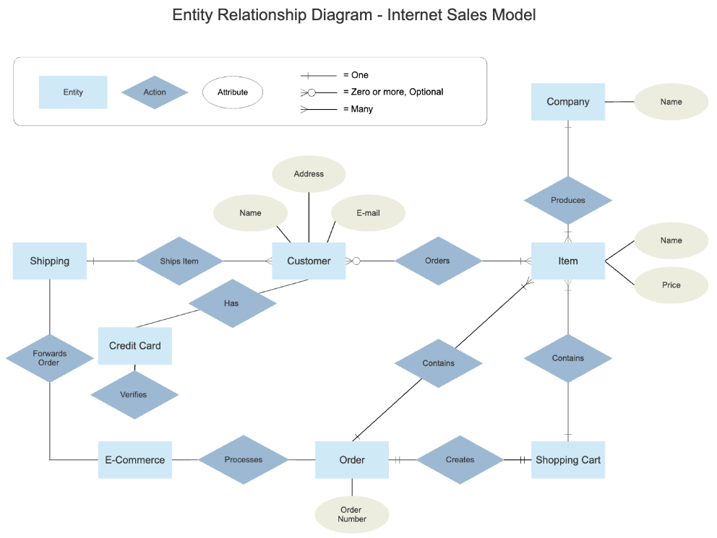
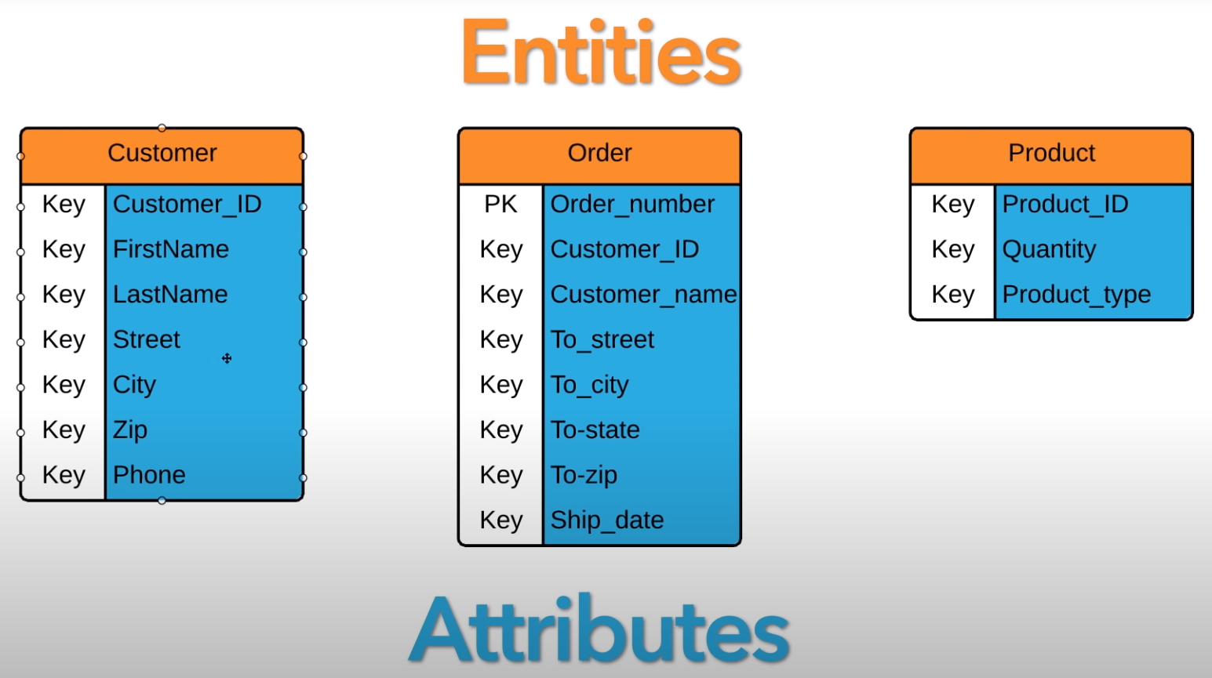
ERD theory:
Showing the relationships of entity sets stored in a database.
An entity is an object, a component of data.
An entity set is a collection of similar entities. These entities can have attributes that define its properties.
By defining the entities, their attributes, and showing the relationships between them, an ER diagram illustrates the logical structure of databases.
ER diagrams are used to sketch out the design of a database.

Slide 2
Common ERD Symbols:
There are five main components of an ERD:
Entity
An Entity is an object or concept about which you want to store information.
Entity
A Weak Entity is an entity that must defined by a foreign key relationship with another entity as it cannot be uniquely identified by its own attributes alone.
Relationship
Actions, which are represented by diamond shapes, show how two entities share information in the database
Attribute
A key attribute is the unique, distinguishing characteristic of the entity.
Attribute
A multivalued attribute can have more than one. For example, an employee entity can have multiple skill values.
Attribute
A derived attribute is based on another attribute. For example, an employee's monthly salary is based on the employee's annual salary.

Slide 3
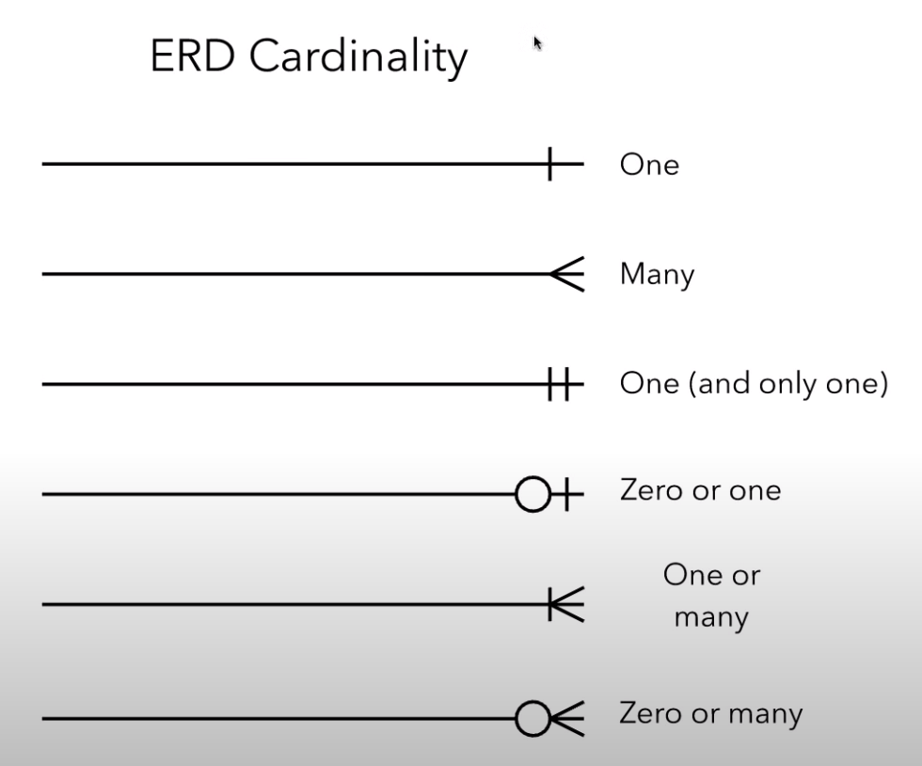
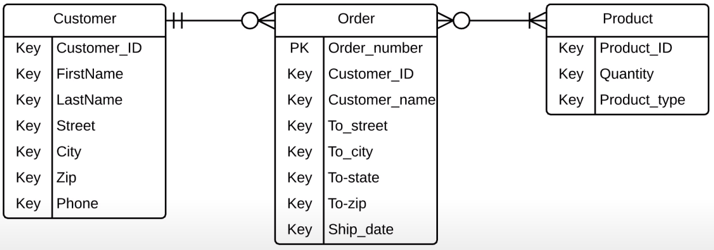
Relationship:
There are four types of relationships:
One-to-one: One entity is related to another single entity known as one relationship.
For example, a person can have only one voter ID card, so the relationship among them will be one-to-one only.
One-to-many: When an entity is related to more than one entity, then this relation is known as a one-to-many relationship.
For example, a relation between customer and order. Here a customer can place many orders, but many customers cannot place an order.
Many to one: When more than one entity is related to a single entity, this is called a many-to-one relationship.
For example, a relation between student and school, many students can study in a single school, but vice versa is not possible.
Many to many: When more than one entity is related to more than one entity, this is called many to many relationships.
For example, a relationship between students and subjects will be the best example of this as many students read many subjects and vice versa.

Slide 4
Convert ERD to Relational Database Schema:
Bước 1: chuyển mỗi loại thực thể thành một loại quan hệ tương ứng
Chuyển các mối kết hợp 1-1 gom 2 thực thể thành một thực thể
Các mối kết hợp 1-N lấy khóa bên thực thể nhiều chuyển thành khóa ngoại
Các mối quan hệ N-N hình thành một loại quan hệ mới
Bước 2: Kiểm tra lại dạng chuẩn của các mối quan hệ.

